Slide 1
SPEAKER PORTAL ORIENTATION
MAY 17, 2023
1:00 – 2:00 PM EASTERN

Slide 2
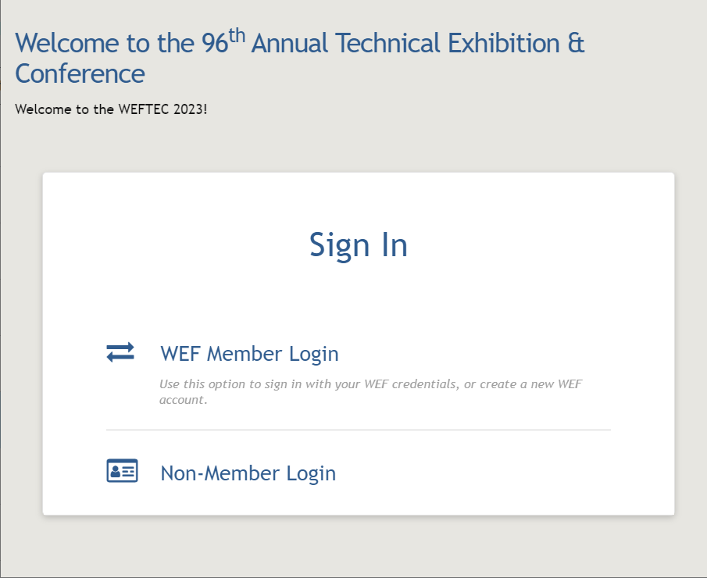
GETTING STARTED: LOGGING IN
WEF Members
Log in using your WEF Membership information.
If you do not remember your password, you must email csc@wef.org for a password reset.
Non-members
Log in credentials can be found in your acceptance/invitation email.
If you still have trouble logging in, email speakers@wef.org.

Slide 3
Participation

Slide 4
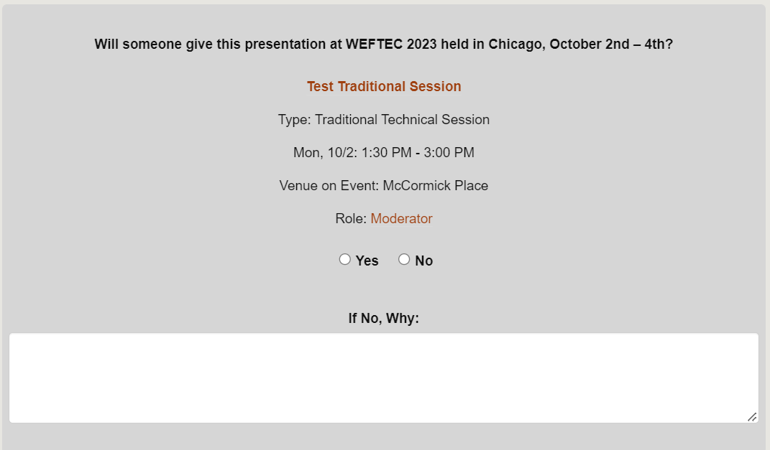
PARTICIPATION CONFIRMATION
PRESENTATION/SESSION TITLE
INTERACTIVE/TRADITIONAL
PRESENTATION/SESSION TIME
SPEAKER/MODERATOR/FACILITATOR
CONFIRMATION
Only select NO if you intend to completely withdraw your paper. If you are unavailable and have a co-author who can take your place, select YES and you will be able to change the speaker after entering the portal.

Slide 5
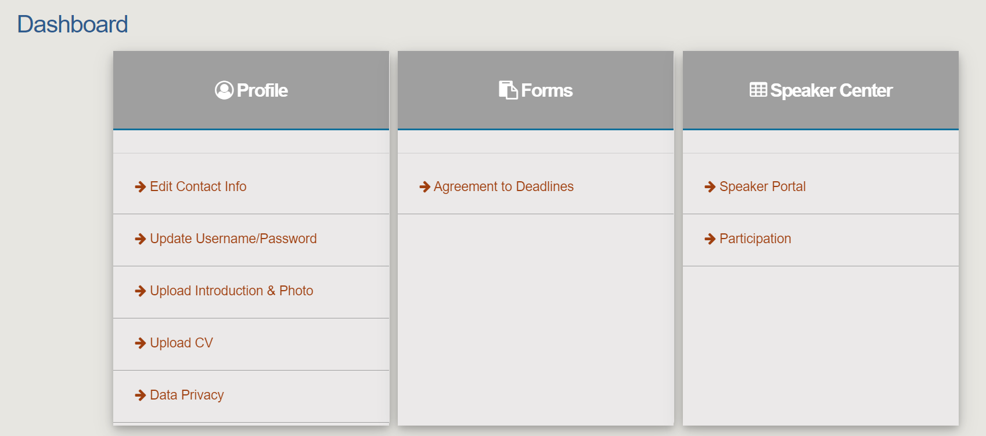
SPEAKER PORTAL DASHBOARD
Click the DASHBOARD button found in the upper left-hand corner from any page to easily navigate the speaker portal.

Slide 6
CONTACT INFO

Slide 7
SPEAKER PORTAL DASHBOARD
Upon entering the Speaker Portal, click EDIT CONTACT INFO to confirm your email address and company information.
WEF Members: The speaker portal will pull your information from the Membership Database the first time you log in. After that, any changes you make in the Speaker Portal will remain; however, they will not affect your WEF Membership profile.
We recommend any changes made in the speaker portal should be made on your membership profile as well.
The contact information provided to the speaker portal will be used for all speakers, moderators, and facilitators to remain in contact with each other leading up to WEFTEC.

Slide 8
SPEAKER PORTAL

Slide 9
ENTERING YOUR READY ROOM
Click SPEAKER PORTAL to enter your SPEAKER READY ROOM where you will find information for your assigned sessions.
Your introduction to the speaker portal and download links for all Informational Packets can be found at the top of your ready room.
If you have not done so, please download and review your packet.

Slide 10
SPEAKER READY ROOM
SESSION TITLE
The most important task within the speaker portal will be to click on your session title. This allows you to view your session breakdown, which includes:
Agenda
Description
Guide (for interactive sessions)
Learning Objectives
Focus Areas
Moderator/Facilitator/ Speaker Contact Information

Slide 11
SPEAKER READY ROOM
PRESENTATION TITLE
SESSION TITLE
Confirmed message lets you know the task has been completed.
Opened tasks will appear as a blue button for you to click and complete the task.
Ex: Participation is now open and will close on May 22nd.
Closed tasks may appear but can only be completed when they become a blue button.

Slide 12
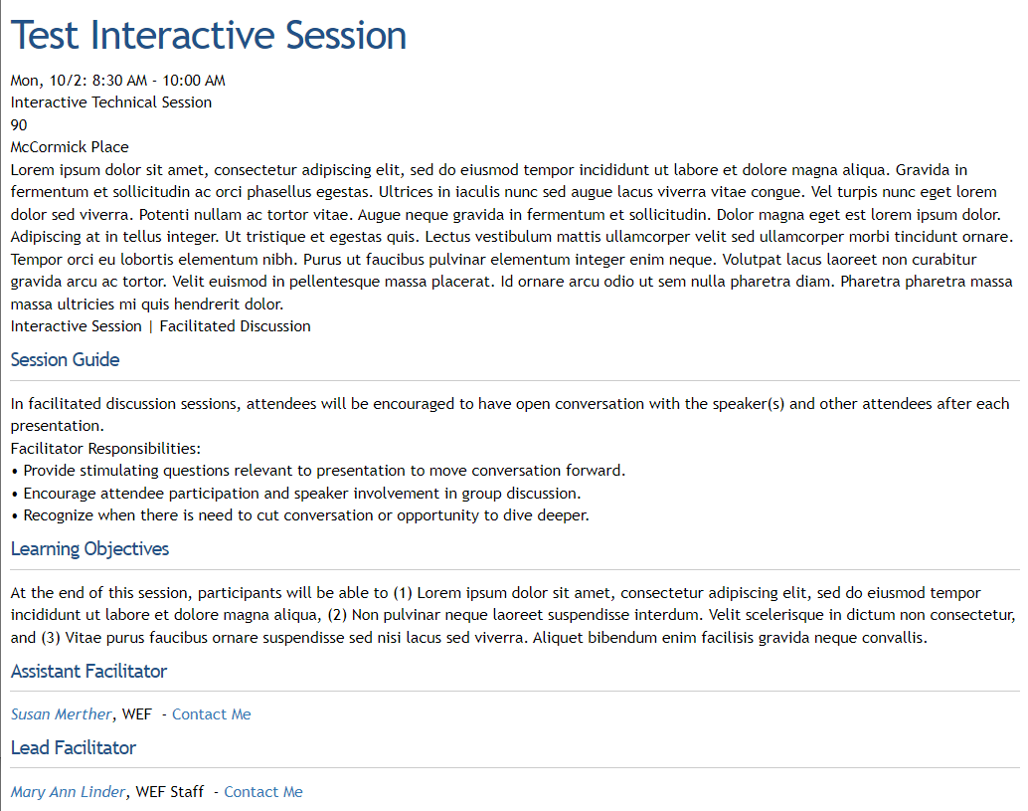
SPEAKER READY ROOM
SESSION TITLE
DESCRIPTION
GUIDE (interactive session guide)
CONTACT INFORMATION

Slide 13
SPEAKER READY ROOM
After clicking on an individual’s name their contact info becomes available to you.

Slide 14
SPEAKER READY ROOM
Authors upload the abstract’s final paper to the speaker portal.
Presenting Authors (Speaker) upload the presentation slides and present at WEFTEC.
Beginning on June 1st, Authors and Invited Speakers will be able to see the WEFTEC 2023 LICENSE AGREEMENT-PAPER and SUBMIT PAPER buttons.
Incomplete message lets you know the task needs to be done.

Slide 15
EDIT SPEAKER

Slide 16
UPDATING AUTHORS AND SPEAKERS
Click EDIT SPEAKER to find where you can change who is presenting at WEFTEC or add/remove co-authors.
PRESENTATION TITLE
Find the presentation title of the presentation you would like to edit, select MANAGE SPEAKER/CO-AUTHOR to make changes to presenters and/or co-authors.

Slide 17
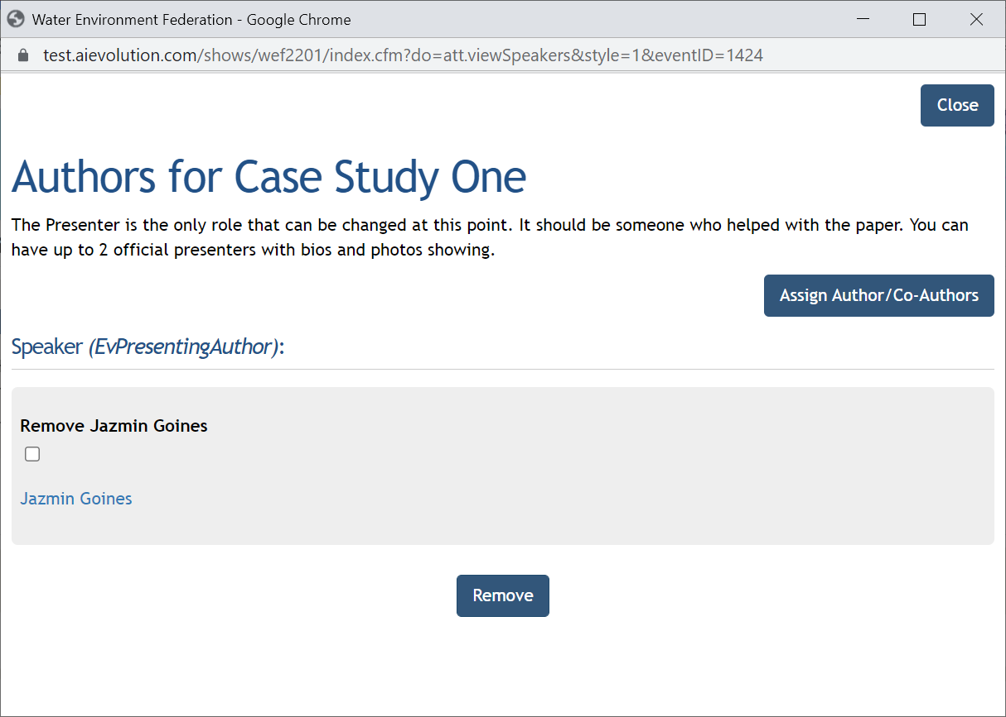
ADDING AUTHORS AND SPEAKERS
To begin the process of adding a speaker or co-author, click the ASSIGN AUTHOR/CO-AUTHORS button.

Slide 18
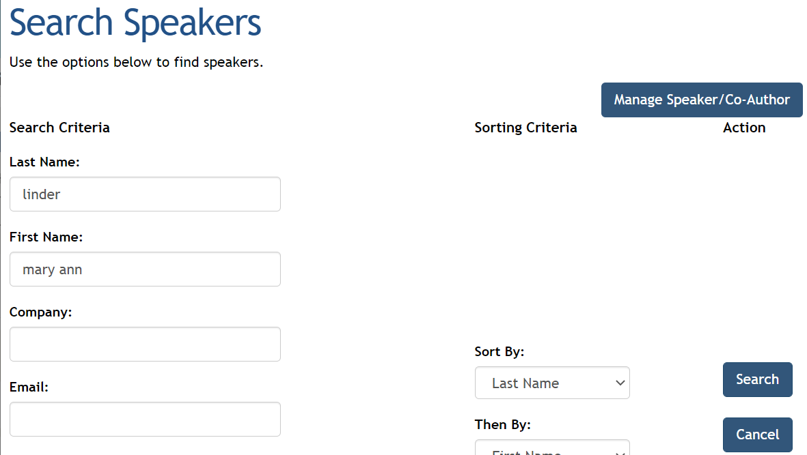
ADDING AUTHORS AND SPEAKERS
Enter the one or all the following to search for the person you would like to add:
Last Name
First Name
Email
Once you have entered this information, click SEARCH.

Slide 19
ADDING AUTHORS AND SPEAKERS
Once the search result have pulled, select rather you will be adding the person as a Co-author or a Presenting Author (Speaker), then select ASSIGN.

Slide 20
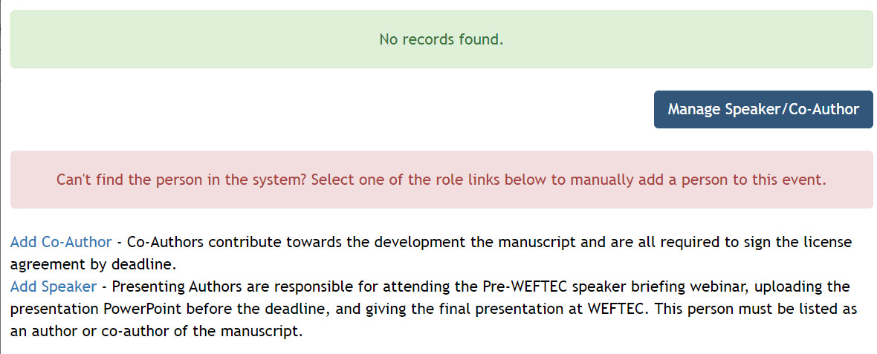
ADDING AUTHORS AND SPEAKERS
If your search does not get any results and you received the NO RECORDS FOUND message, use ADD CO-AUTHOR or ADD SPEAKER to add them into the system manually. After entering the name, company, work phone, and email of the new speaker, they will be added to the presentation.

Slide 21
REMOVING AUTHORS AND SPEAKERS
Make sure to add desired speakers before removing any speakers. If you remove yourself from a session or presentation, you will no longer have access to the speaker portal.
To remove a speaker, click the check box near the speaker’s name followed by the REMOVE button.

Slide 22
BIO
RESUME/CV

Slide 23
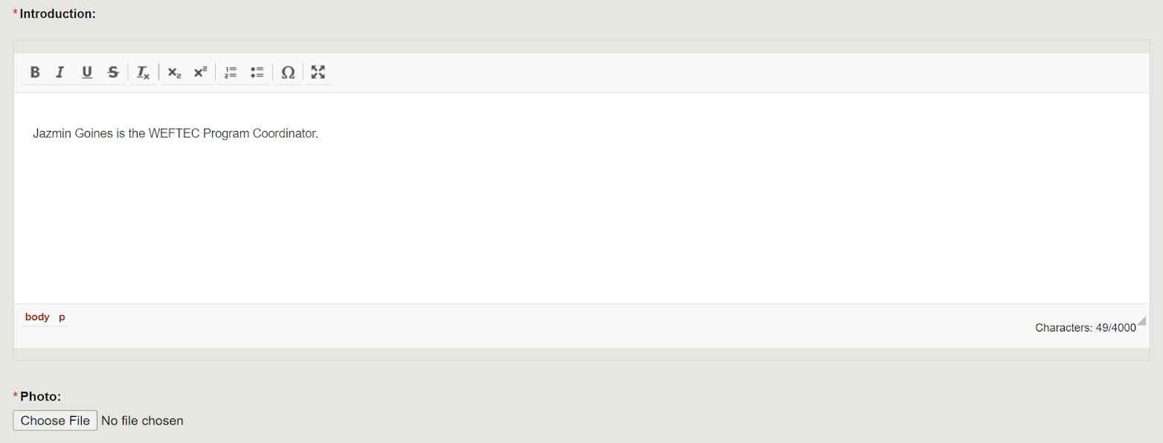
UPLOADING SPEAKER INTRODUCTION AND PHOTO
Click UPLOAD INTRODUCTION & PHOTO to be directed to the area where you can upload both your introduction and photo.
Type your short introduction into the box provided and use the CHOOSE FILE button to upload a headshot.

Slide 24
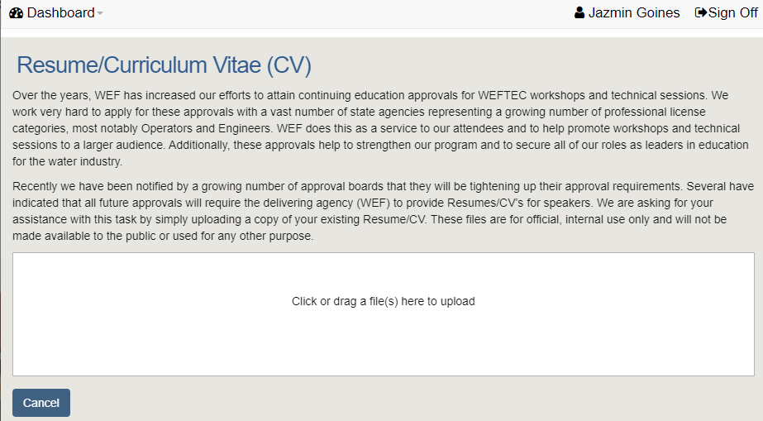
UPLOADING SPEAKER RESUME/CV
Click UPLOAD CV to be directed to the area where you can upload both your resume/cv.
Upload a PDF version of your resume/cv by clicking and dragging the file into the upload box.
Once the file appears in the upload box, fill in the DOCUMENT TYPE then press UPLOAD.

Slide 25
QUESTIONS?

